Slide 1
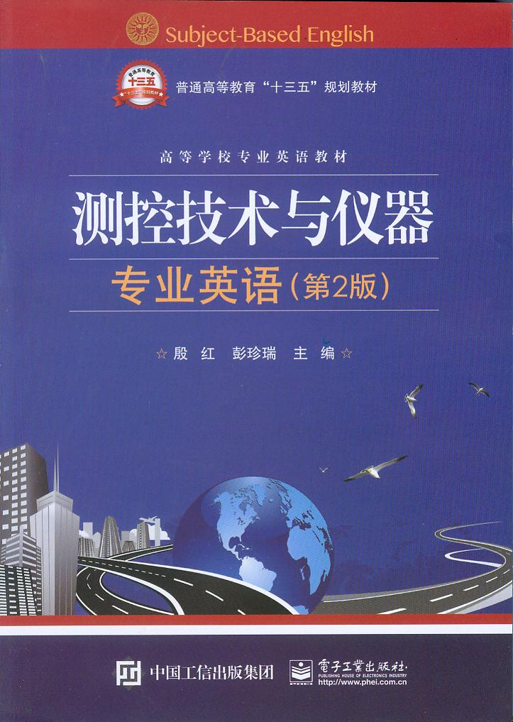
Unit 1 Measurement, Control and Instrumentation

Slide 2
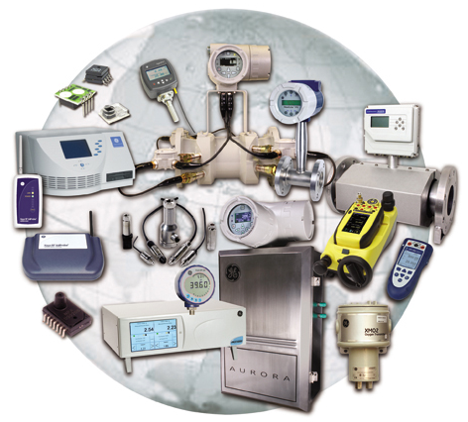
Unit 1 Measurement, Control and Instrumentation

Slide 3
Instrumentation is defined as the art and science of measurement and control. Instrumentation engineers are responsible for controlling a whole system like a power plant.
仪器仪表学定义为测量和控制的艺术和科学。仪器工程师负责控制整套系统，如发电厂。
An instrument is a device that measures and/or regulates process variables such as flow, temperature, level, or pressure. Instruments include many varied contrivances that can be as simple as valves and transmitters, and as complex as analyzers.
仪器是测量和（或）调节过程变量（如流量，温度，物位或压力）的设备。仪器包括许多各种不同的发明，它们可以像阀和变送器一样简单，也可以像分析仪一样复杂。

Slide 4
Output instrumentation includes devices such as solenoids, valves, regulators, circuit breakers, and relays. These devices control a desired output variable, and provide either remote or automated control capabilities. These are often referred to as final control elements when controlled remotely or by a control system.
句中desired output variable意为“期望输出变量”，are referred to as意为“被称为”。
全句译为：输出仪器包括电磁阀、阀门、调节器、断路器和中继器等元件。这些元件控制期望输出变量，使之实现远程或自动控制功能。在远程控制或自动控制系统中，称这些元件为终端控制元件。

Slide 5
Control Instrumentation plays a significant role in both gathering information from the field and changing the field parameters, and as such are a key part of control loops.
句中field意为“现场”，control loops意为“控制回路”。
全句译为：控制仪器在现场信息采集和现场参数转换中都起到了重要作用。这本身是控制回路的一个关键部分。

Slide 6
History
In the early years of process control, process indicators and control elements such as valves were monitored by an operator that walked around the unit adjusting the valves to obtain the desired temperatures, pressures, and flows. As technology evolved pneumatic controllers(气压式调节器) were invented and mounted（安装，配有）in the field that monitored the process and controlled the valves.
在过程控制的早期，像阀这样的过程指示器和控制元件通过操作人员监控，他们忙碌在装置周围，调节阀门以获得期望的温度、压力和流量。随着技术的发展，发明了气动控制器，安装于现场，监控过程，控制阀门。

Slide 7
This reduced the amount of time process operators were needed to monitor the process. Later years the actual controllers were moved to a central room and signals were sent into the control room to monitor the process and outputs signals were sent to the final control element such as a valve to adjust the process as needed.
近几年，实际控制转移到中央控制室，信号被发送到控制室来监测过程，并且输出信号被送到终端控制元件，如阀门，根据需要调节过程。降低了过程操作人员监控过程所需的时间。最近几年，实际控制器移到中央控制室，信号送到中央控制室监控过程，输出信号送到终端控制元件，如阀，调节所需过程。

Slide 8
These controllers and indicators were mounted on a wall called a control board.
译为：这些控制器和指示器安装在一个壁面上，称其为控制面板。
The operators stood in front of this board walking back and forth monitoring the process indicators. This again reduced the number and amount of time process operators were needed to walk around the units. The basic air signal used during these years was 3～15 psig(磅/平方英寸).
操作人员站在控制面板前面，来回走动，监控过程指示器。这再次减少了过程操作人员往返于各设备单元之间所需的时间。近年里使用的基本气动信号为3～15磅/平方英寸。

Slide 9
The transformation of instrumentation from mechanical pneumatic transmitters, controllers, and valves to electronic instruments reduced maintenance costs as electronic instruments were more dependable than mechanical instruments. This also increased efficiency and production due to their increase in accuracy.
句中reduced为transformation的谓语，as引导原因状语从句。
全句译为：从机械气动变送器、控制器和阀的控制方式向电子仪器控制方式的转变，降低了维修成本，因为电子仪器比机械仪器更可靠。由于电子仪器精度的提高，生产效率和生产力也提高了。

Slide 10
With the exception of a few seemingly fundamental quantum constants, units of measurement are essentially arbitrary; in other words, people make them up and then agree to use them.
句中With the exception of意为“除……以外”，quantum constants意为“量子常数”。
全句译为：除了少数看上去代表基本法则的量子常数以外，测量的单位实质上是很主观的，换句话说，人们编制并愿意使用它就可以了。

Slide 11
Nothing inherent in nature dictates that an inch has to be a certain length, or that a mile is a better measure of distance than a kilometre. Over the course of human history, however, first for convenience and then for necessity, standards of measurement evolved so that communities would have certain common benchmarks（基准）. Laws regulating measurement were originally developed to prevent fraud （欺诈，欺骗行为；骗子） in commerce.
没有什么事物能固有地表示一英寸有多长，也不能说英里是比千米是更好的长度测量单位。然而，遍及人类的历史进程，首先考虑的是方便，然后是需求，测量标准不断演化以使大家有一个共同的基准。监管测量的法规的发展一开始就为了预防商业中的欺诈。

Slide 12
Measurement methods are often scrutinized（仔细检查，详审） for their validity, applicability, and accuracy. It is very important that the scope of the measurement method be clearly defined, and any aspect included in the scope is shown to be accurate and repeatable through validation.
测量方法通常要仔细审查其有效性，适用性和精确性。明确定义测量方法的适用范围是非常重要的。使用范围中的各个方面都要通过校验表明是精确的和可重复性的。
Measurement method validations often encompass（围绕；包围）the following considerations:
测量方法的有效性通常从以下几方面考虑：

Slide 13
Control
In addition to measuring field parameters, instrumentation is also responsible for providing the ability to modify some field parameters.
除了测试现场参数，仪器也用于修改一些现场参数。
Modern day control engineering (also called control systems engineering) is a relatively new field of study that gained a significant attention during 20th century with the advancement in technology.
近年来，控制工程（也称为控制系统工程）是20世纪随着控制技术的发展受到极大关注的相对较新的研究领域。

Slide 14
It seeks to understand physical systems, using mathematical modeling, in terms of inputs, outputs and various components with different behaviors; use control systems design tools to develop controllers for those systems; and implement controllers in physical systems employing available technology.
主语it代指“control engineering”，句子中的3个并列成分understand，use和implement为seeks to的宾语。
全句译为：控制工程根据输入、输出和不同性质的各种元件，建立数学模型，分析物理系统。使用控制系统设计工具来为这些系统开发控制器。在物理系统中运用有效的技术来执行这些控制器。

Slide 15
Control engineering is based on the foundations of feedback theory and linear system analysis, and it integrates the concepts of network theory and communication theory. Therefore control engineering is not limited to any engineering discipline but is equally applicable to aeronautical, chemical, mechanical, environmental, civil, and electrical engineering.
控制工程是基于反馈理论和线性系统分析基础的，它结合了网络理论和通信理论的概念。因此控制工程不再局限于任何工程学科，而是同样适用于航空、化学、机械、环境、土木和电子工程中。

Slide 16
The second revolution, which is happening even as we speak, is replacement of the standard 4- to 20-mA analog signals for communication throughout a process plant by serial digital communication via a network.
句中plant指“被控对象”。serial digital communication指“串行数字通信”。全句译为：第二场革命，我们可以说正在发生，在过程对象控制中，用网络中的串行数字通信取代了通信中标准的4-20mA的模拟信号。

Slide 17
Computer control
CAutoD can be applied not just to tuning a predefined control scheme, but also to controller structure optimisation, system identification and invention of novel control systems, based purely upon a performance requirement, independent of any specific control scheme.
句中not just to…but also to…意为“不仅……而且……”，novel control systems意为“新型系统”。
全句译为：计算机自动设计（CAutoD）不仅能用于预定义控制模式的调整，而且可以用于控制器结构优化、系统辨识和新型系统的开发。这一切都仅仅基于设计的性能要求，而不依赖于任何具体的控制模式。

Slide 18
Instrumentation engineering
Instrumentation engineering is the engineering specialization focused on the principle and operation of measuring instruments that are used in design and configuration of automated systems in electrical, pneumatic domains etc.
仪器工程是关于测试仪器原理和使用的工程专业。这些测试仪器用于设计和构建电动或气动等领域的自动化系统。

Slide 19
Instrumentation technologists
Instrumentation technologists, technicians and mechanics specialize in troubleshooting(发现并修理故障，解决纷争)and repairing and maintenance of instruments and instrumentation systems. This trade is so intertwined(缠结在一起)with electricians, pipefitters, power engineers, and engineering companies, that one can find him/herself in extremely diverse working situations.
仪器技术专家是专门维修仪器仪表系统的技术专家和机械专家。这个行业将电工电子技师，管道维修工，动力工程师和工程公司融合在一起，以至于仪器技术专家发现他自己工作在截然不同的多个领域中。

